Slide 1
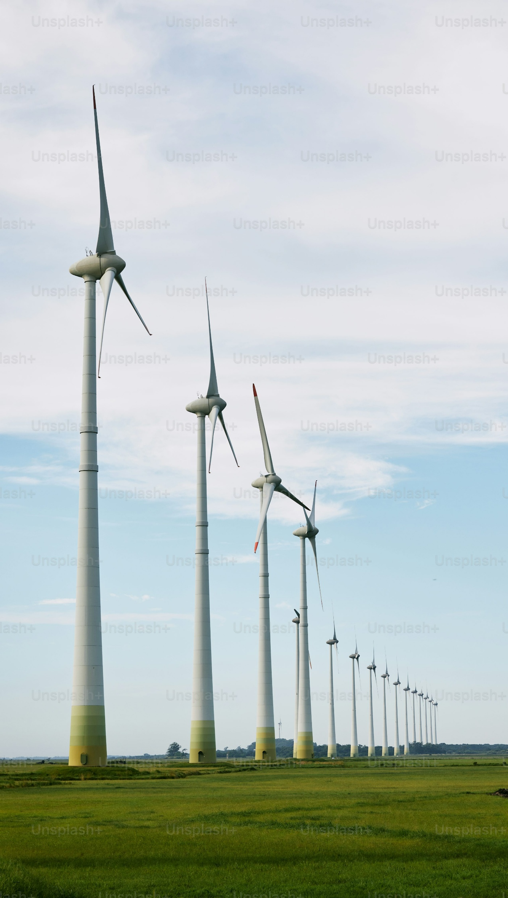
Wind Farm Valuation in Germany
How Carbon Credit Allocation Affects NPV under Spot and Forward Contracts
Chuyang Yu
Master of Science in Engineering Management

Slide 2
Table of Contents
Contexts
Methodology
Output Interpretation
Conclusion and Recommendation

Slide 3
Contexts
Cap-and-Trade system
Government
Companies
California, European Union, China, South Korea, Japan

Slide 4
Contexts
When CO₂ emissions exceed the cap set by the government, companies need carbon credits to offset them.

Slide 5
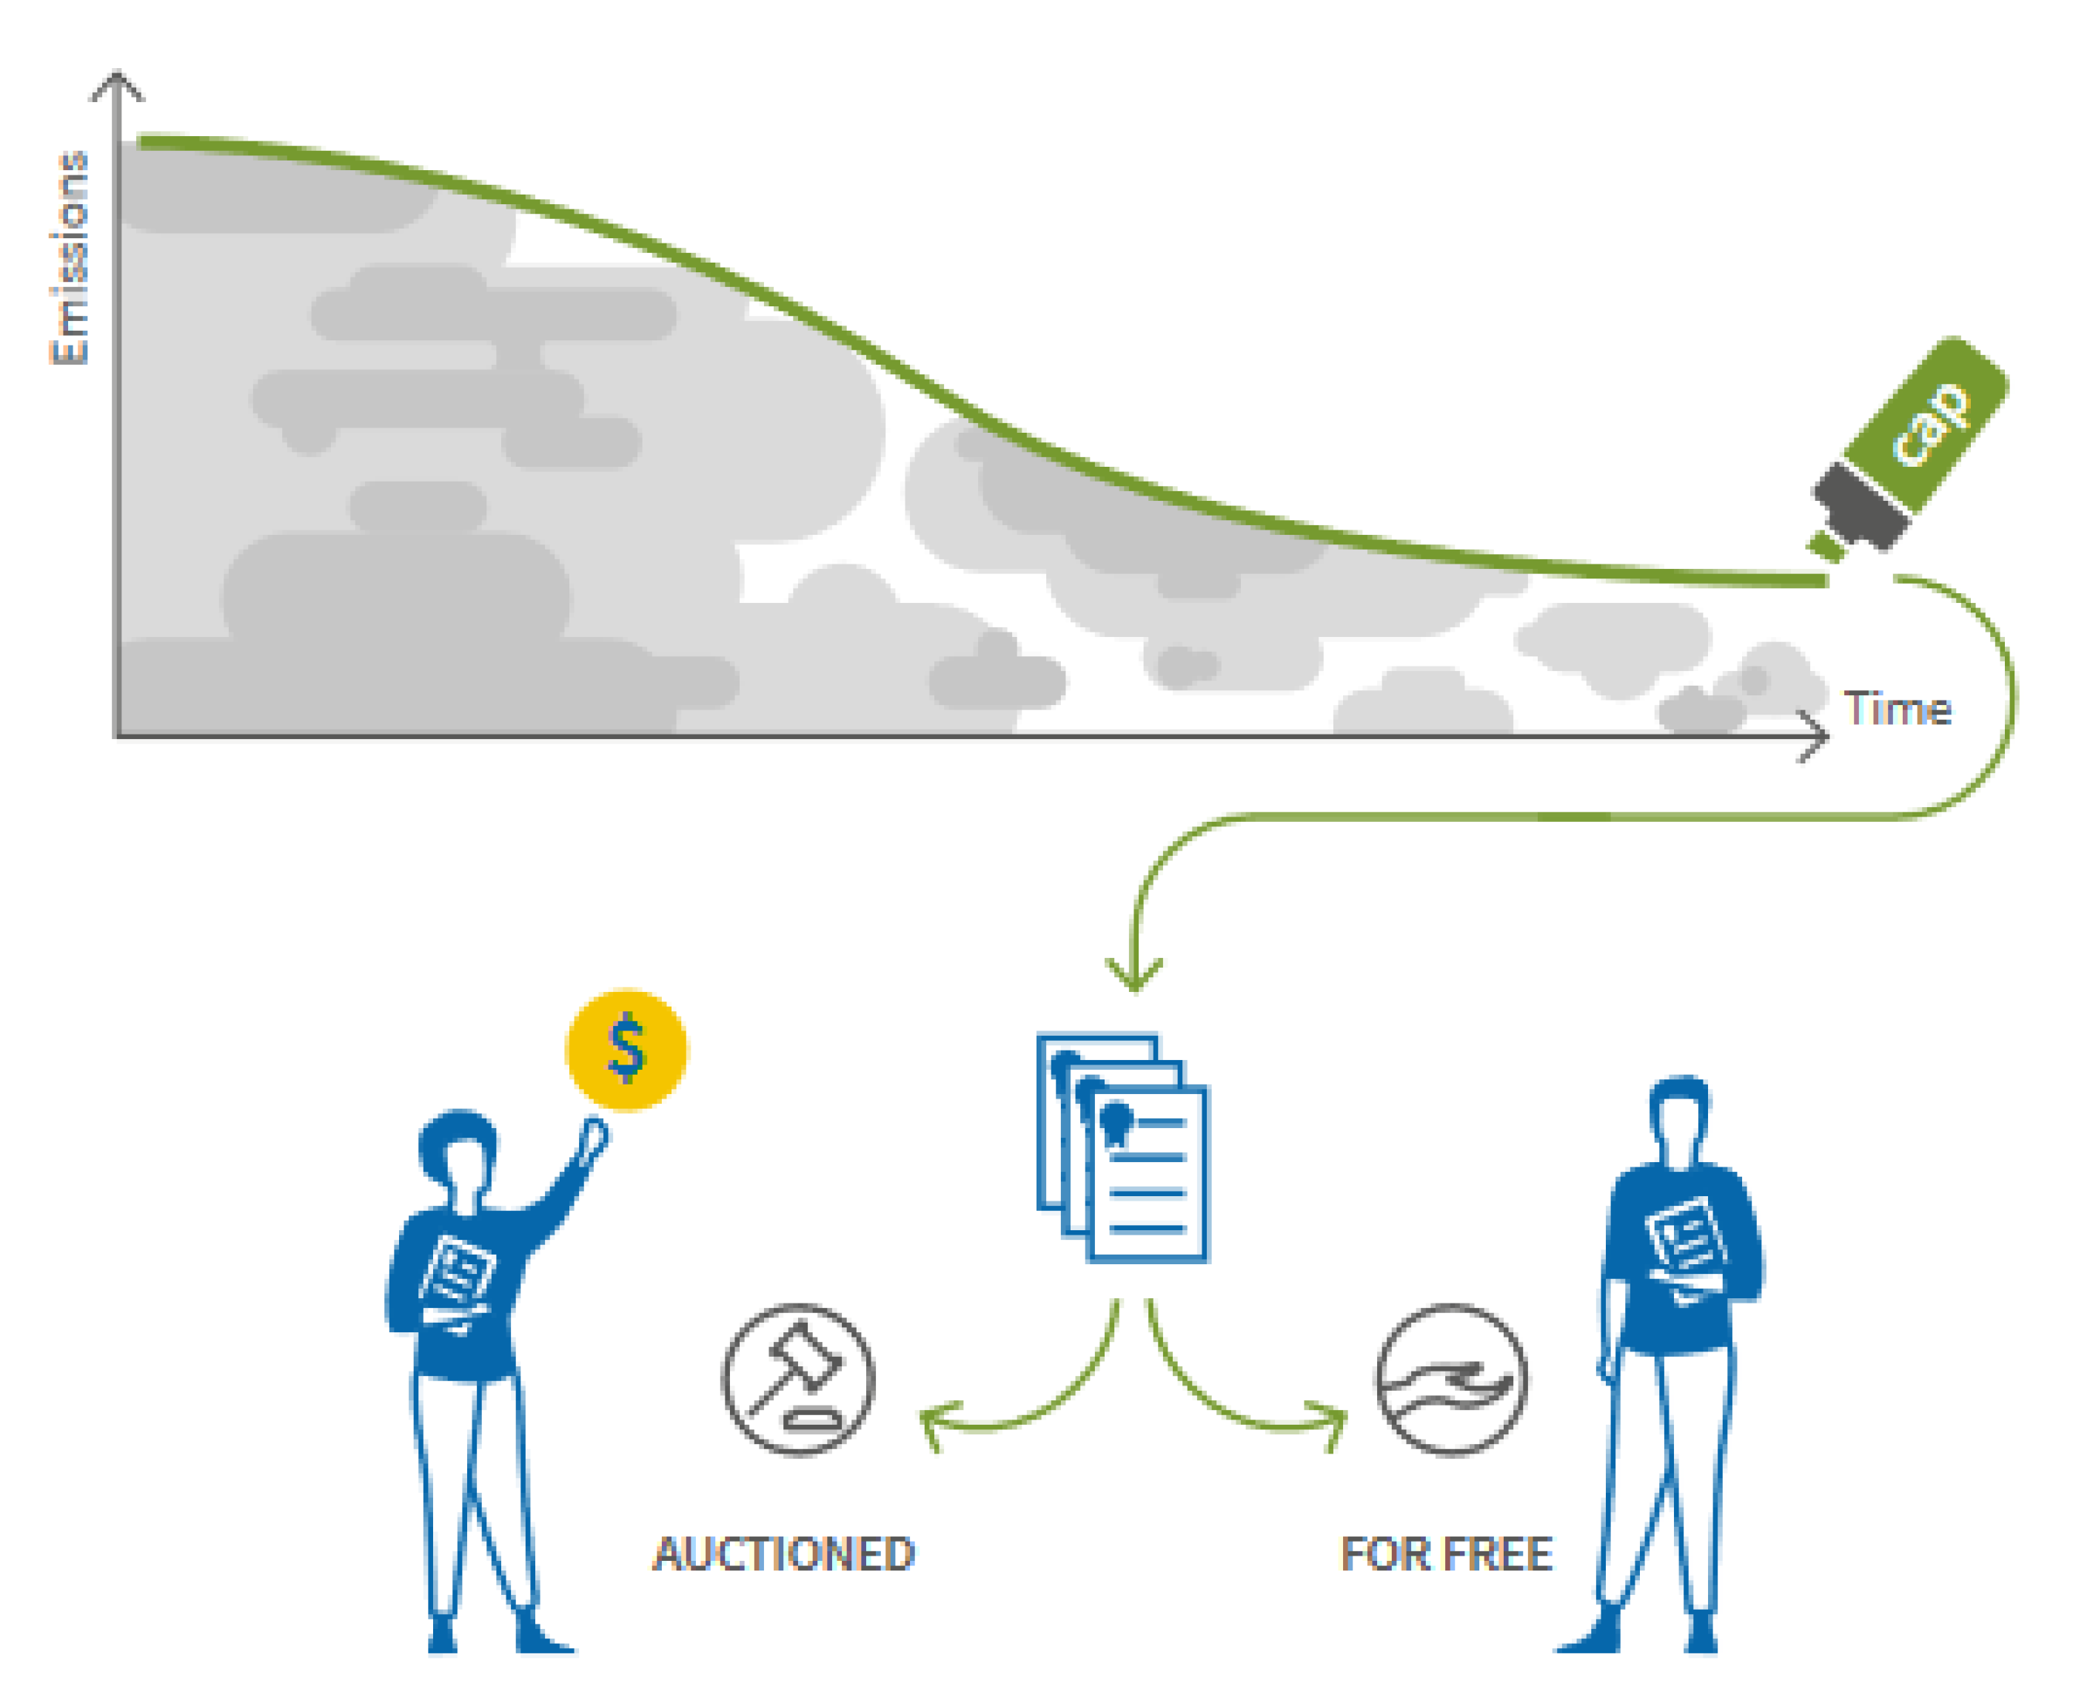
Contexts
https://icapcarbonaction.com/en/allocation

Slide 6
Contexts
Auctioned + allocated for free
1 credit = a reduction of 1 ton of CO₂ or
other greenhouse gas emission
Carbon Credit
The monetary value assigned to this tradable credit
Sell and buy to offset greenhouse gas emissions
Carbon Credit
Price

Slide 7
Contexts
Purchase for excessive emission
Allocation
Sell surplus carbon credit
Cap
0 emission
https://icapcarbonaction.com/en/ets/german-national-emissions-trading-system

Slide 8
Contexts
Carbon Credit Allocated
Carbon credits freely allocated to a wind farm by the government – a benchmark
Emission Factor
Standard CO₂ emissions per MWh, varies by energy source, 0.015 t/MWh for wind farm
100% auction system for the buyers
Companies must purchase all credits at market prices (auction)
Allocation in Germany
https://icapcarbonaction.com/en/ets/german-national-emissions-trading-system

Slide 9
Methodology
Impact of carbon credit allocation introduction to the German carbon credit market
Objectives
Impact of different allocation rate
(0% - without carbon credit, 20%, 50%, 80%)
Impact across different contract types
Spot vs. Forward (1Y, 3Y, 5Y)

Slide 10
Methodology
Data Processing
R, Geometric Brownie Motion, Monte Carlo Simulation
Calculation Flow
Total revenue = Electricity sales revenue + Carbon credit revenue
Electricity sales revenue = Generation (500 MWh) * Price
Carbon credit revenue = Price * Carbon credit allocated
Carbon credit allocated = Allocation rate * Generation * EmFac

Slide 11
Methodology
Spot Price
LPXBHR01 for spot electricity, EEXX04EA for spot carbon price
Simulate future electricity & carbon prices using Monte Carlo
Generate 1000 price paths for 10 years (monthly)
Compute and plot NPV using the Discounted Cash Flow (DCF)
Output
4 histograms: 1 without allocation + 3 allocation rate
* Data from Bloomberg Terminal

Slide 12
Methodology
Forward Contract
ELGBYR1, ELGBYR3, ELGBYR5 for forward electricity
MOZ25, MOZ27, MOZ29 (future) for forward carbon
After the contract expires, prices revert to Spot simulation (n=1000) for the rest 9, 7, and 5 years
Compute and plot NPV using “rbind (forward, spot)”
Output
15 histograms: 3 without allocation + 3 * 4 different rate
* Data from Bloomberg Terminal

Slide 13
Methodology
Spot vs. Forward
Plot NPV confidence interval from 3 aspects
Spot vs. Forward without carbon credit allocation
With vs. without carbon credit allocation in Spot Price
Across different allocation rates in Forward Contract
Output
1 + 1 + 4 error bar plots

Slide 14
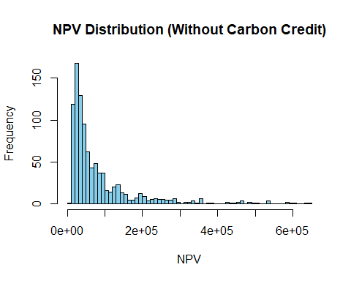
Output – Spot Price
Wind farms must purchase all carbon credits, so NPV is solely determined by electricity sales revenue
NPV remains low, indicating limited profitability under the current 100% auction system

Slide 15
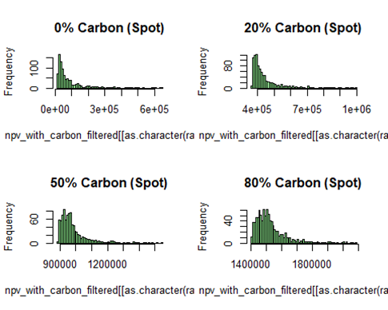
Output – Spot Price
NPV increases compared to the “without allocation” scenario
Higher allocation rates may further increase NPV

Slide 16
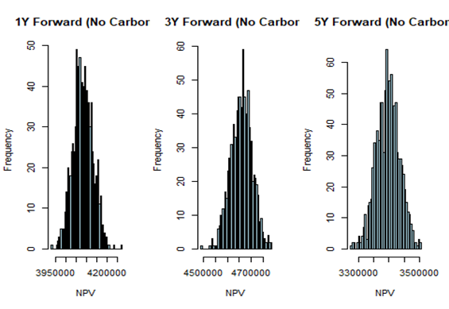
Output – Forward Contract
Longer contracts make revenue more stable
3-year contracts can generate higher revenue

Slide 17
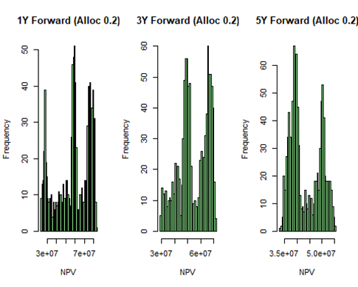
Output – Forward Contract
NPV increases compared to Allocation Rate = 0% (without carbon credit allocated)

Slide 18
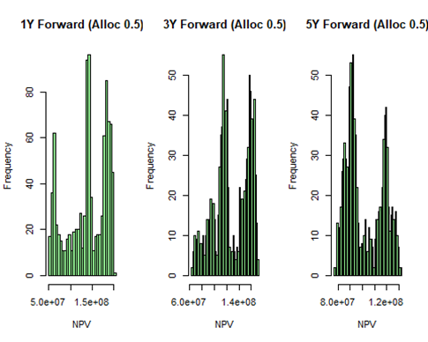
Output – Forward Contract
Increasing the allocation rate to 50% further boosts NPV

Slide 19
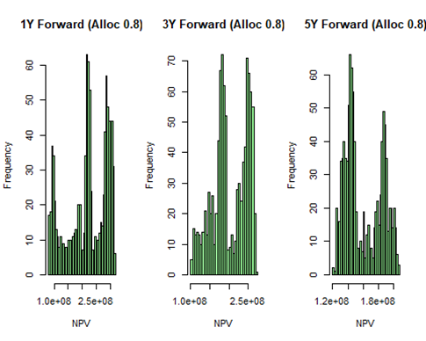
Output – Forward Contract
80% allocation rate yields the highest NPV among the 3 rates, but the increase is not that much when from 20% to 50%

Slide 20
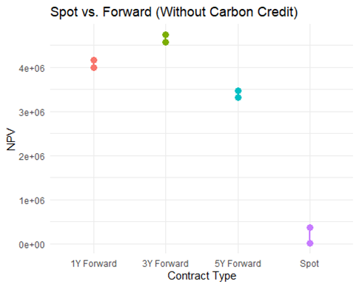
Output – Comparison
Forward contracts show lower NPV variance compared to spot pricing
Forward contracts provide stability, and yield higher returns

Slide 21
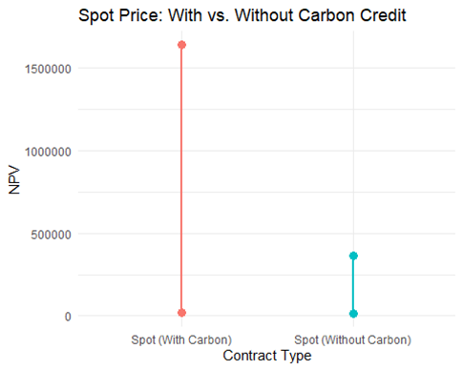
Output – Comparison
NPV is significantly higher with carbon credit allocation compared to without
Greater variance in NPV when carbon credit allocation is included

Slide 22
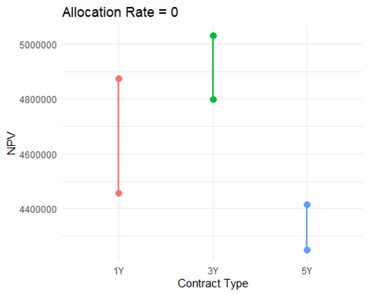
Output – Comparison
No significant difference between forward contract durations when allocation rate = 0%
The same as the previous histogram: longer – more stable; 3Y – highest NPV

Slide 23
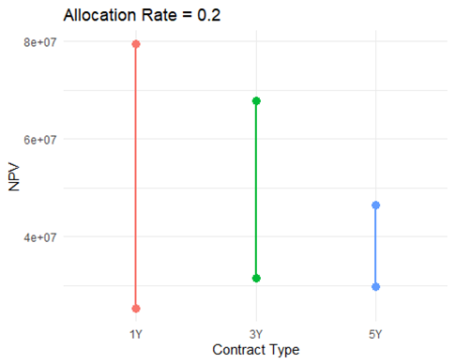
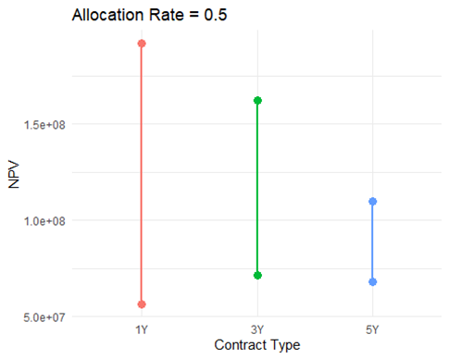
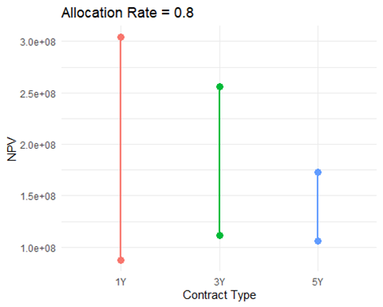
Output – Comparison
Higher allocation rates enhance wind farm NPV under forward contracts, but the increase in NPV from 50% to 80% is smaller than from 20% to 50%
Longer forward contracts (3Y, 5Y) benefit more from carbon credit allocation – more predictable

Slide 24
Conclusion & Recommendation
Conclusion
Recommendation
Carbon credit allocation significantly enhances wind farm valuation
Higher allocation rates generally lead to better financial outcomes
Forward contracts offer more stable valuation but are highly sensitive to carbon credit allocation
We can introduce carbon credit allocation to improve wind farm valuation and encourage investment.
A moderate allocation rate (50%) may provide an optimal balance
We can consider forward contracts with carbon credit allocation as a more stable investment option

Slide 25
Thanks
Chuyang Yu
Master of Science in Engineering Management

